Slide 1
PASSIVE SOLAR WATER WALL

Slide 2
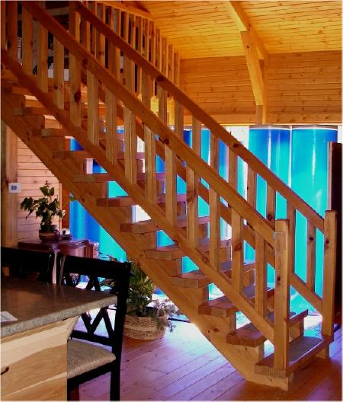

Slide 3
Called Passive Solar Water Wall, their unusual cooling system revolves around a rectangular water tank fitted into a wall — its very high surface area allows maximum interaction between the air and the tank walls, thus helping it cool rapidly. The heat absorbed is continuously removed from the system by daily household use of water.
ACs contribute to about 35 percent of total household electricity consumption and produces 1.5 tonnes of carbon every year. The passive solar water wall takes these considerations into account. Which is why its benefits include no CFC and carbon emission, minimal electricity usage and a whopping 50 percent reduction in cooling cost!

Slide 4
SMART CAN

Slide 5
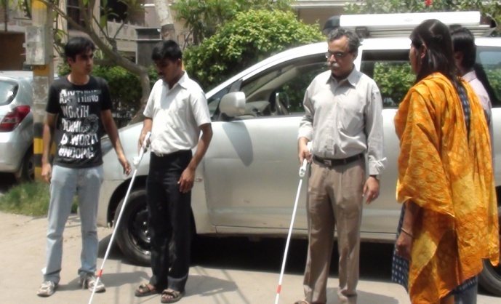
2. SmartCane

Slide 6
India is home to the largest population of visually challenged people in the world and many of them use the traditional white cane to move about. However, this cane can only help them detect obstacles on the ground and within a maximum range of half to one meter.
Thus, blind people often bump into hazardous over-hanging branches, protruding ACs, signboards and parked vehicles. Apart from causing injury, these unwanted collisions are awkward or unsettling and make them anxious, severely limiting their independent mobility.
To overcome this hurdle, a group of passionate technologists, an IIT professor and a social entrepreneur joined hands and came up with SmartCane. The foldable, light-weight and robust cane helps its user diagnose any above-the-knee obstruction from a distance of 3 meters. Frugality and resourcefulness have ensured that this product costs only INR 3,000

Slide 7


